Slide 1
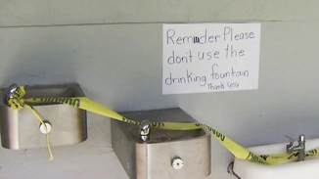
SAFE WATER IN OUR SCHOOLS
Notes:
https://www.opb.org/news/series/lead/portland-public-school-lead-in-water-fountains/

Slide 2
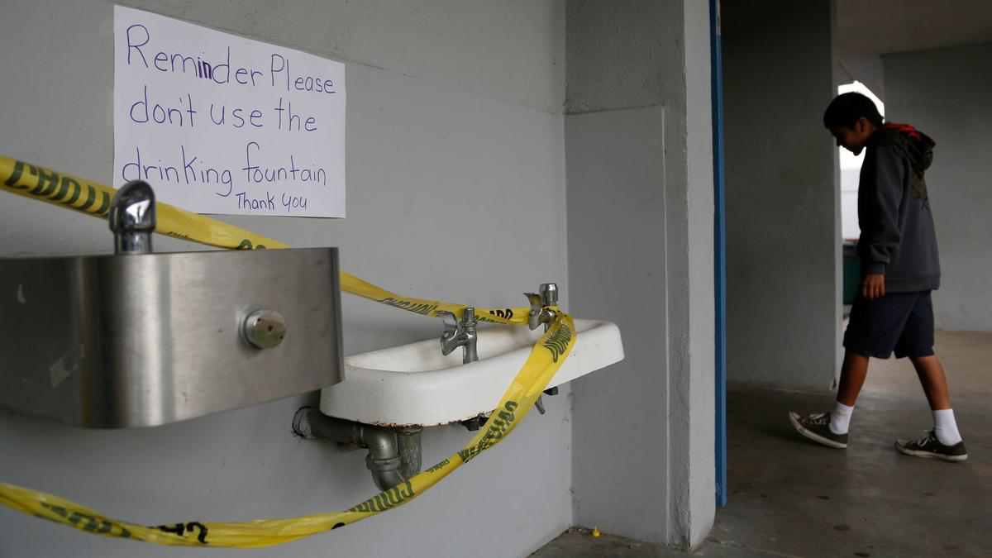
What do you notice?
What do you wonder?

Slide 3
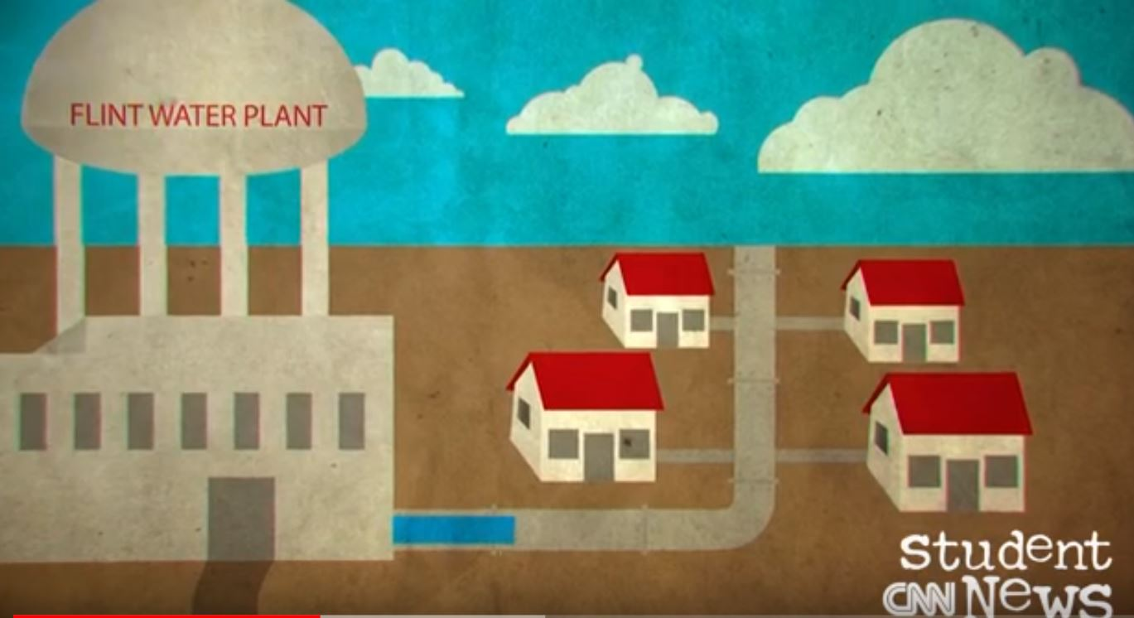
Water Crisis in Flint Michigan - Video

Slide 5
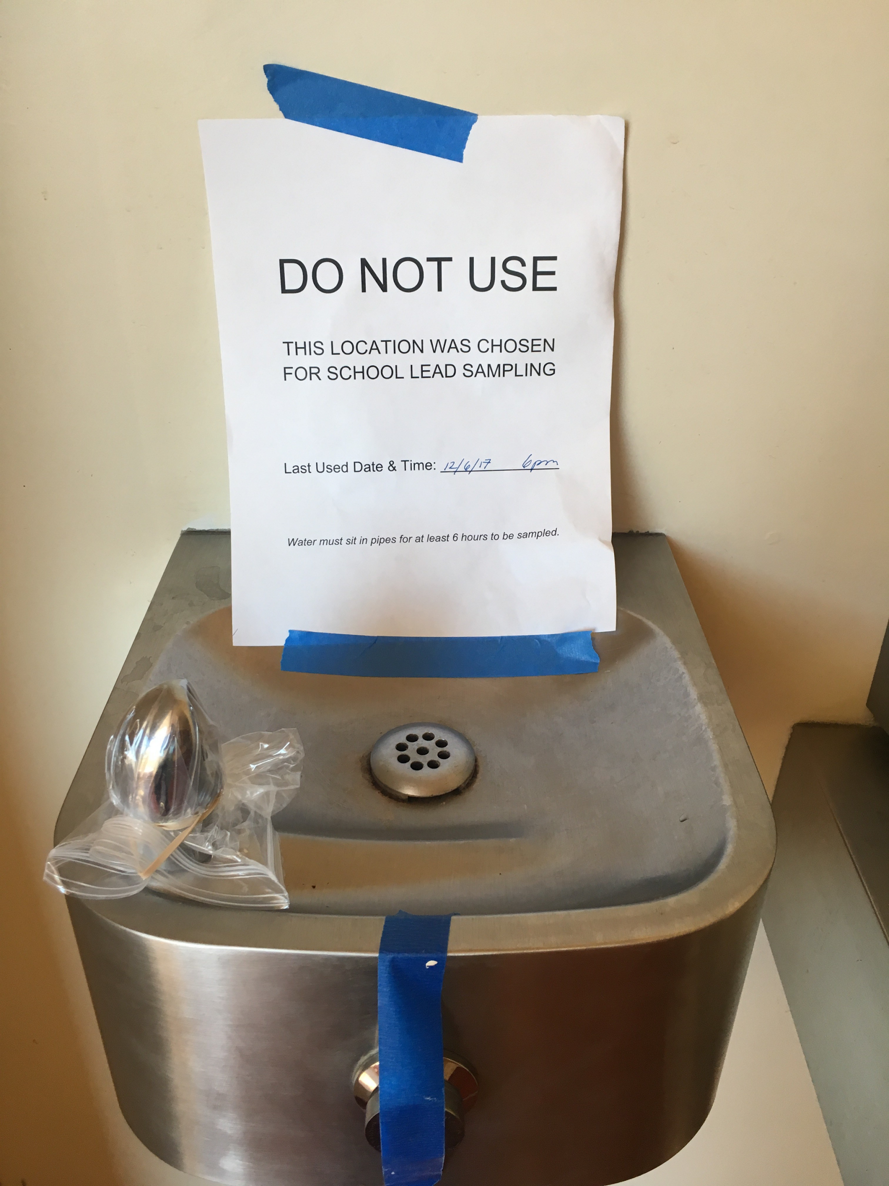
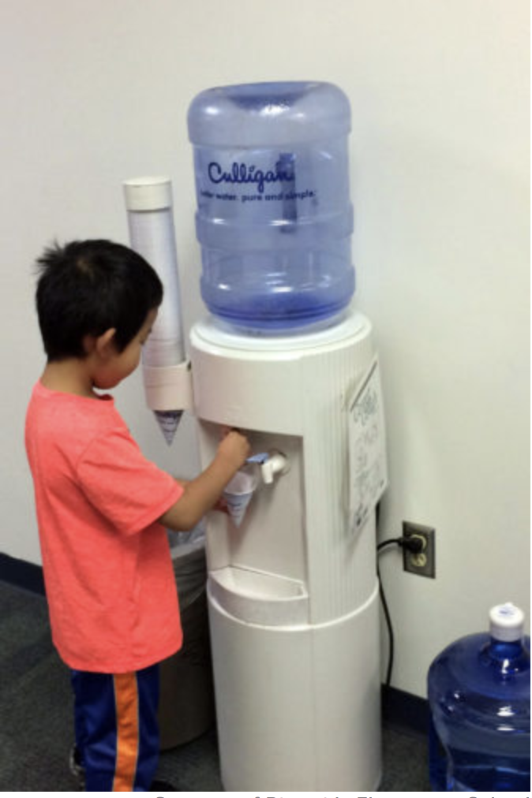
What do you notice?
What do you wonder?

Slide 6
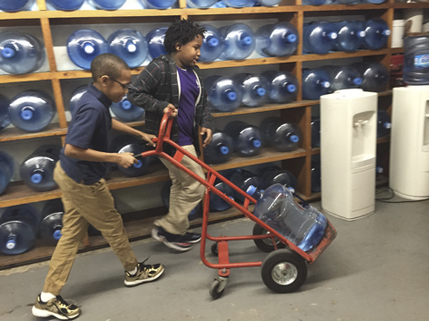
What do you notice?
What do you wonder?
What questions can be answered with mathematics?
Notes:
https://www.npr.org/2016/03/16/470512927/before-flint-lead-contaminated-water-plagued-schools-across-u-s

Slide 7
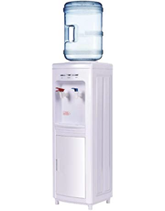
Every year, schools check the drinking water for poisonous chemicals such as lead and copper. In some schools, water fountains are not safe. Signs are posted, “do not use.” If our school water fountains were unsafe, each classroom would use a water dispenser with a large jug of water to make sure everyone has enough water to drink.

Slide 8
If our water fountains were unsafe, how many large jugs of water would we need to make sure that everyone in our class has enough drinking water for 1 school day?
What do we KNOW that will help us? | What do we need to know or find out? | What do we need to decide? What assumptions do we need to make?
Notes:
same comments

Slide 9
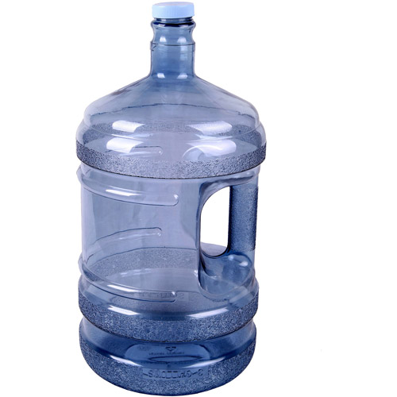
WATER JUGS
A large jug holds 5 gallons of water.
There are 16 cups in 1 gallon.
HOW MUCH WATER DO WE NEED TO DRINK EACH DAY?
Here are recommendations for how much water people should drink each day.
Age | How many cups of water per day?
4 to 8 years old | 5 cups
9 to 13 years old | 7-8 cups
14-18 years old, and adults | 8-10 cups

Slide 10
WATER JUGS
A large jug holds 5 gallons of water.
There are 128 ounces in 1 gallon.
HOW MUCH WATER DO WE NEED TO DRINK EACH DAY?
Here are recommendations for how much water people should drink each day.
Age | How many ounces of water per day?
4 to 8 years old | 40 ounces
9 to 13 years old | 56-64 ounces
14-18 years old, and adults | 64-80 ounces

Slide 11
Your Plan should include:
Your assumptions and decisions important to your plan
How many large jugs are needed
How you know you will have enough drinking water for everyone in our class for one school day
How others could use your plan help their schools have enough water
Extension:
How many jugs of water would we need so that everyone in our class has enough drinking water for 1 week of school? 1 month of school?

Slide 12
Important assumptions and decisions made
How many large jugs of water do we need? __________________
Use pictures, numbers, and words to show that your plan will work.
What directions would you give a student who wanted to make a plan for safe water for their class?

Slide 13
Different Video Options
Student News CNN on Flint Water Crisis
https://www.youtube.com/watch?v=BkKw_-pLEDo&index=10&list=PLTc0nEfdp_f2yywvicWsABFuYSYzQ6mU5
March 2019 CBS News Report on Lead in Water at Schools
https://www.youtube.com/watch?v=2rnFccygFYI
https://www.youtube.com/watch?v=IHMs6LqqW0Y
Water Crisis in Schools in Detroit
https://www.youtube.com/watch?v=ea0V3pltNTk
https://www.youtube.com/watch?v=H64-OYnY8Oo (short clip of water cooler station at schools)
https://www.youtube.com/watch?v=Tx1CUcdO748

