Slide 1
Making
Picture Frames
To honor our loved ones

Slide 2
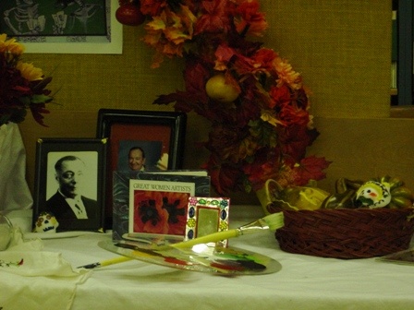
https://educationalmaterialscenter.wordpress.com
What do you notice? What do you wonder?

Slide 3
http://wikiarts.pbworks.com/w/page/14204855/Dia%20de%20los%20Muertos%20Open%20House
What do you notice? What do you wonder?

Slide 4
https://www.facebook.com/Cinemex/photos/pcb.10156877777648289/10156877771308289/?type=3&theater

Slide 5
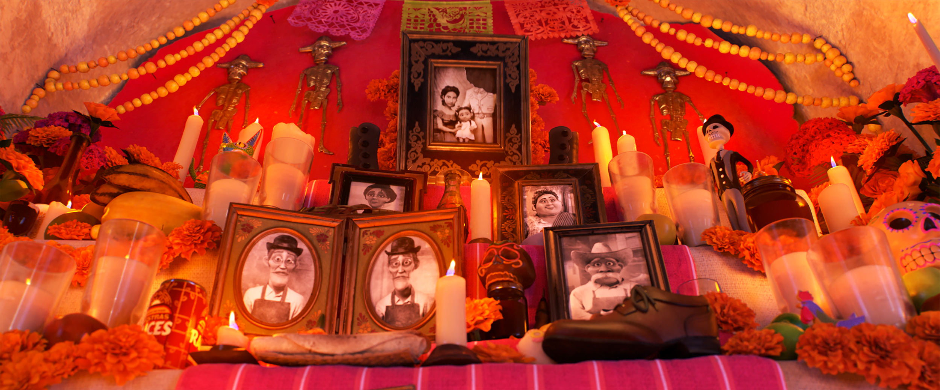
https://www.pixar.com/feature-films/coco/#coco-main

Slide 6
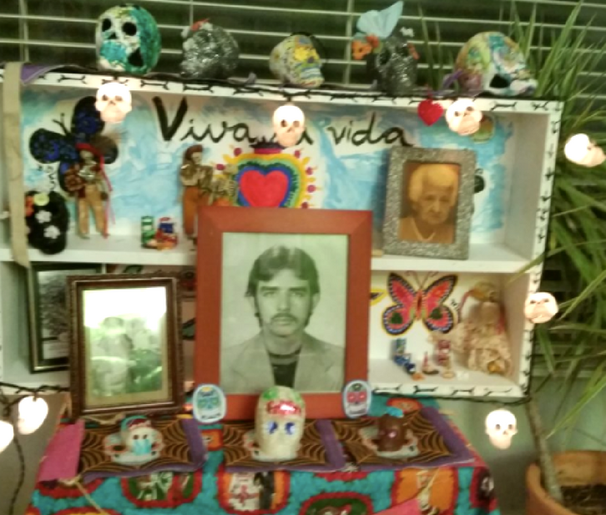
Displays to Honor Our Loved Ones
Do you make this kind of display in your home? In your community?
Have you ever seen this kind of display here in Renton?
What is often included in a display to honor those we love like our family, friends, pets and community members?

Slide 7
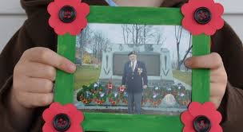
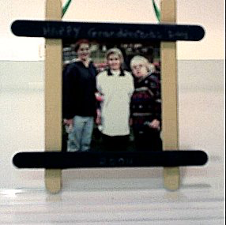
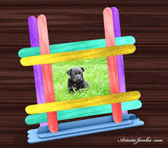
We are going to make Picture Frames to Create a Class Display to honor our loved ones.

Slide 8
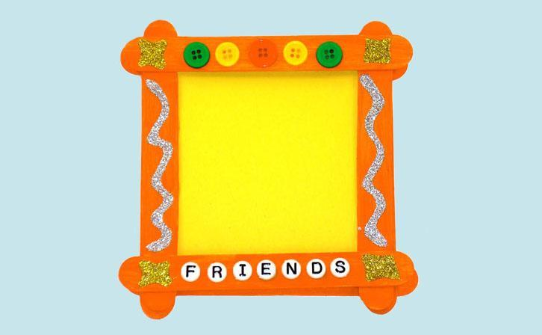
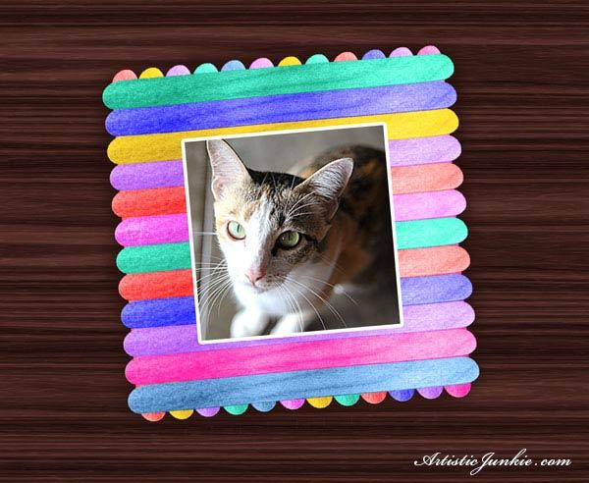
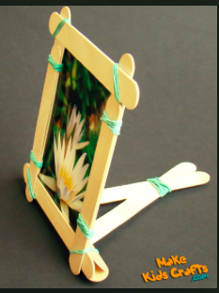
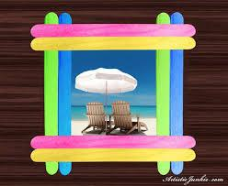
What do you notice about these picture frames? How are they alike? How how they different?

Slide 9
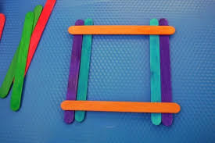
Different Kinds of Frames
4 Stick Frame
8 Stick Frame
6 Stick Frame

Slide 10
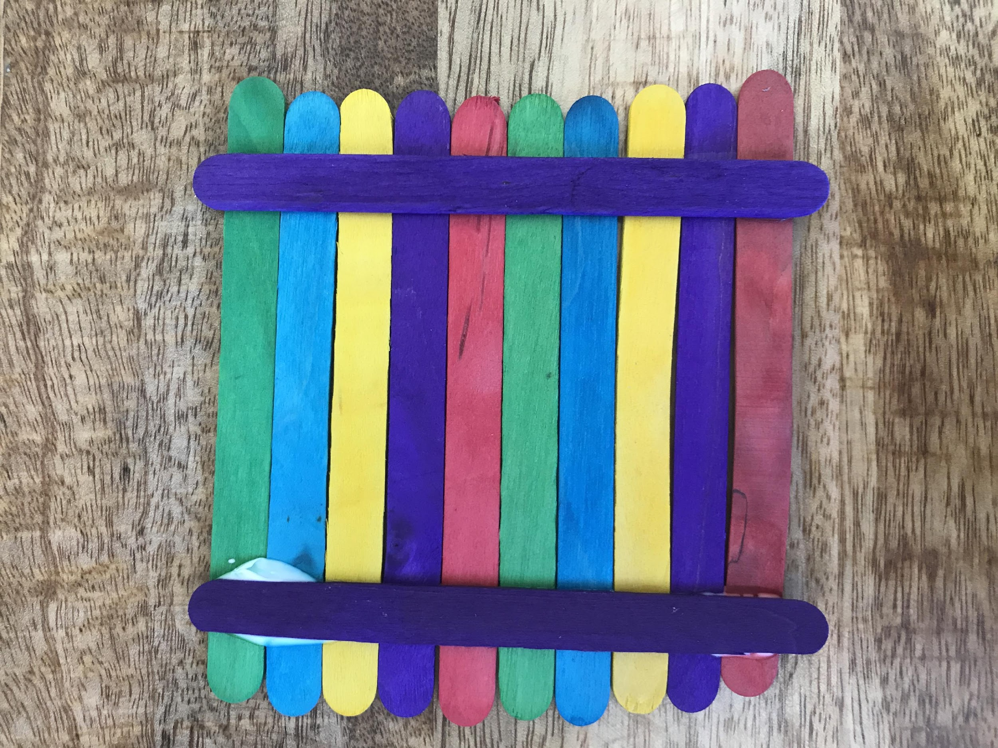
Frames with Vertical Sticks
Front Back

Slide 11
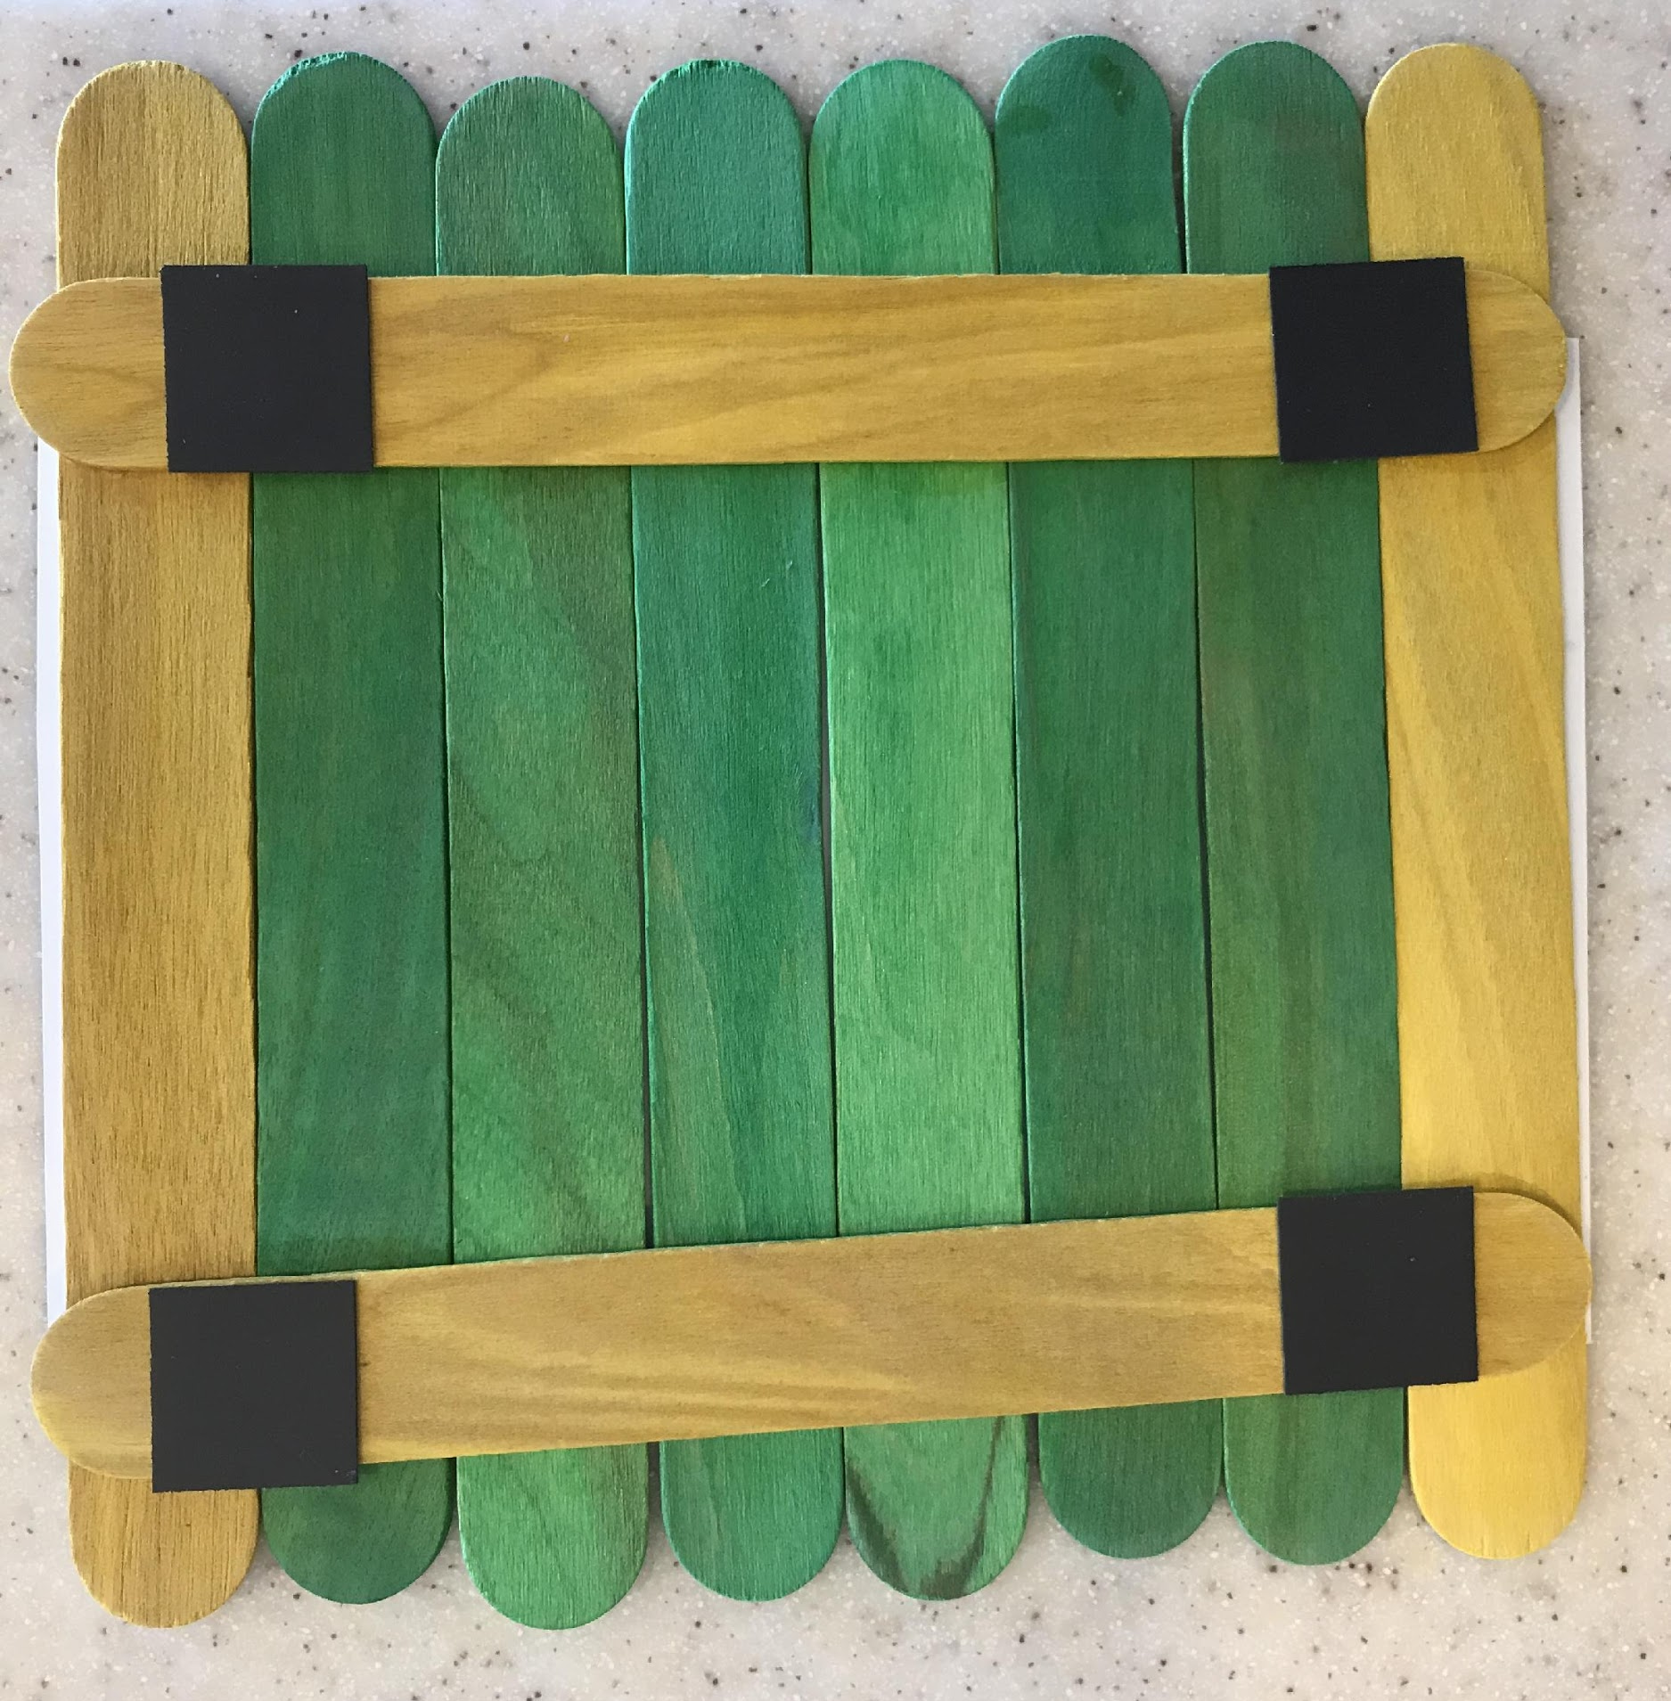
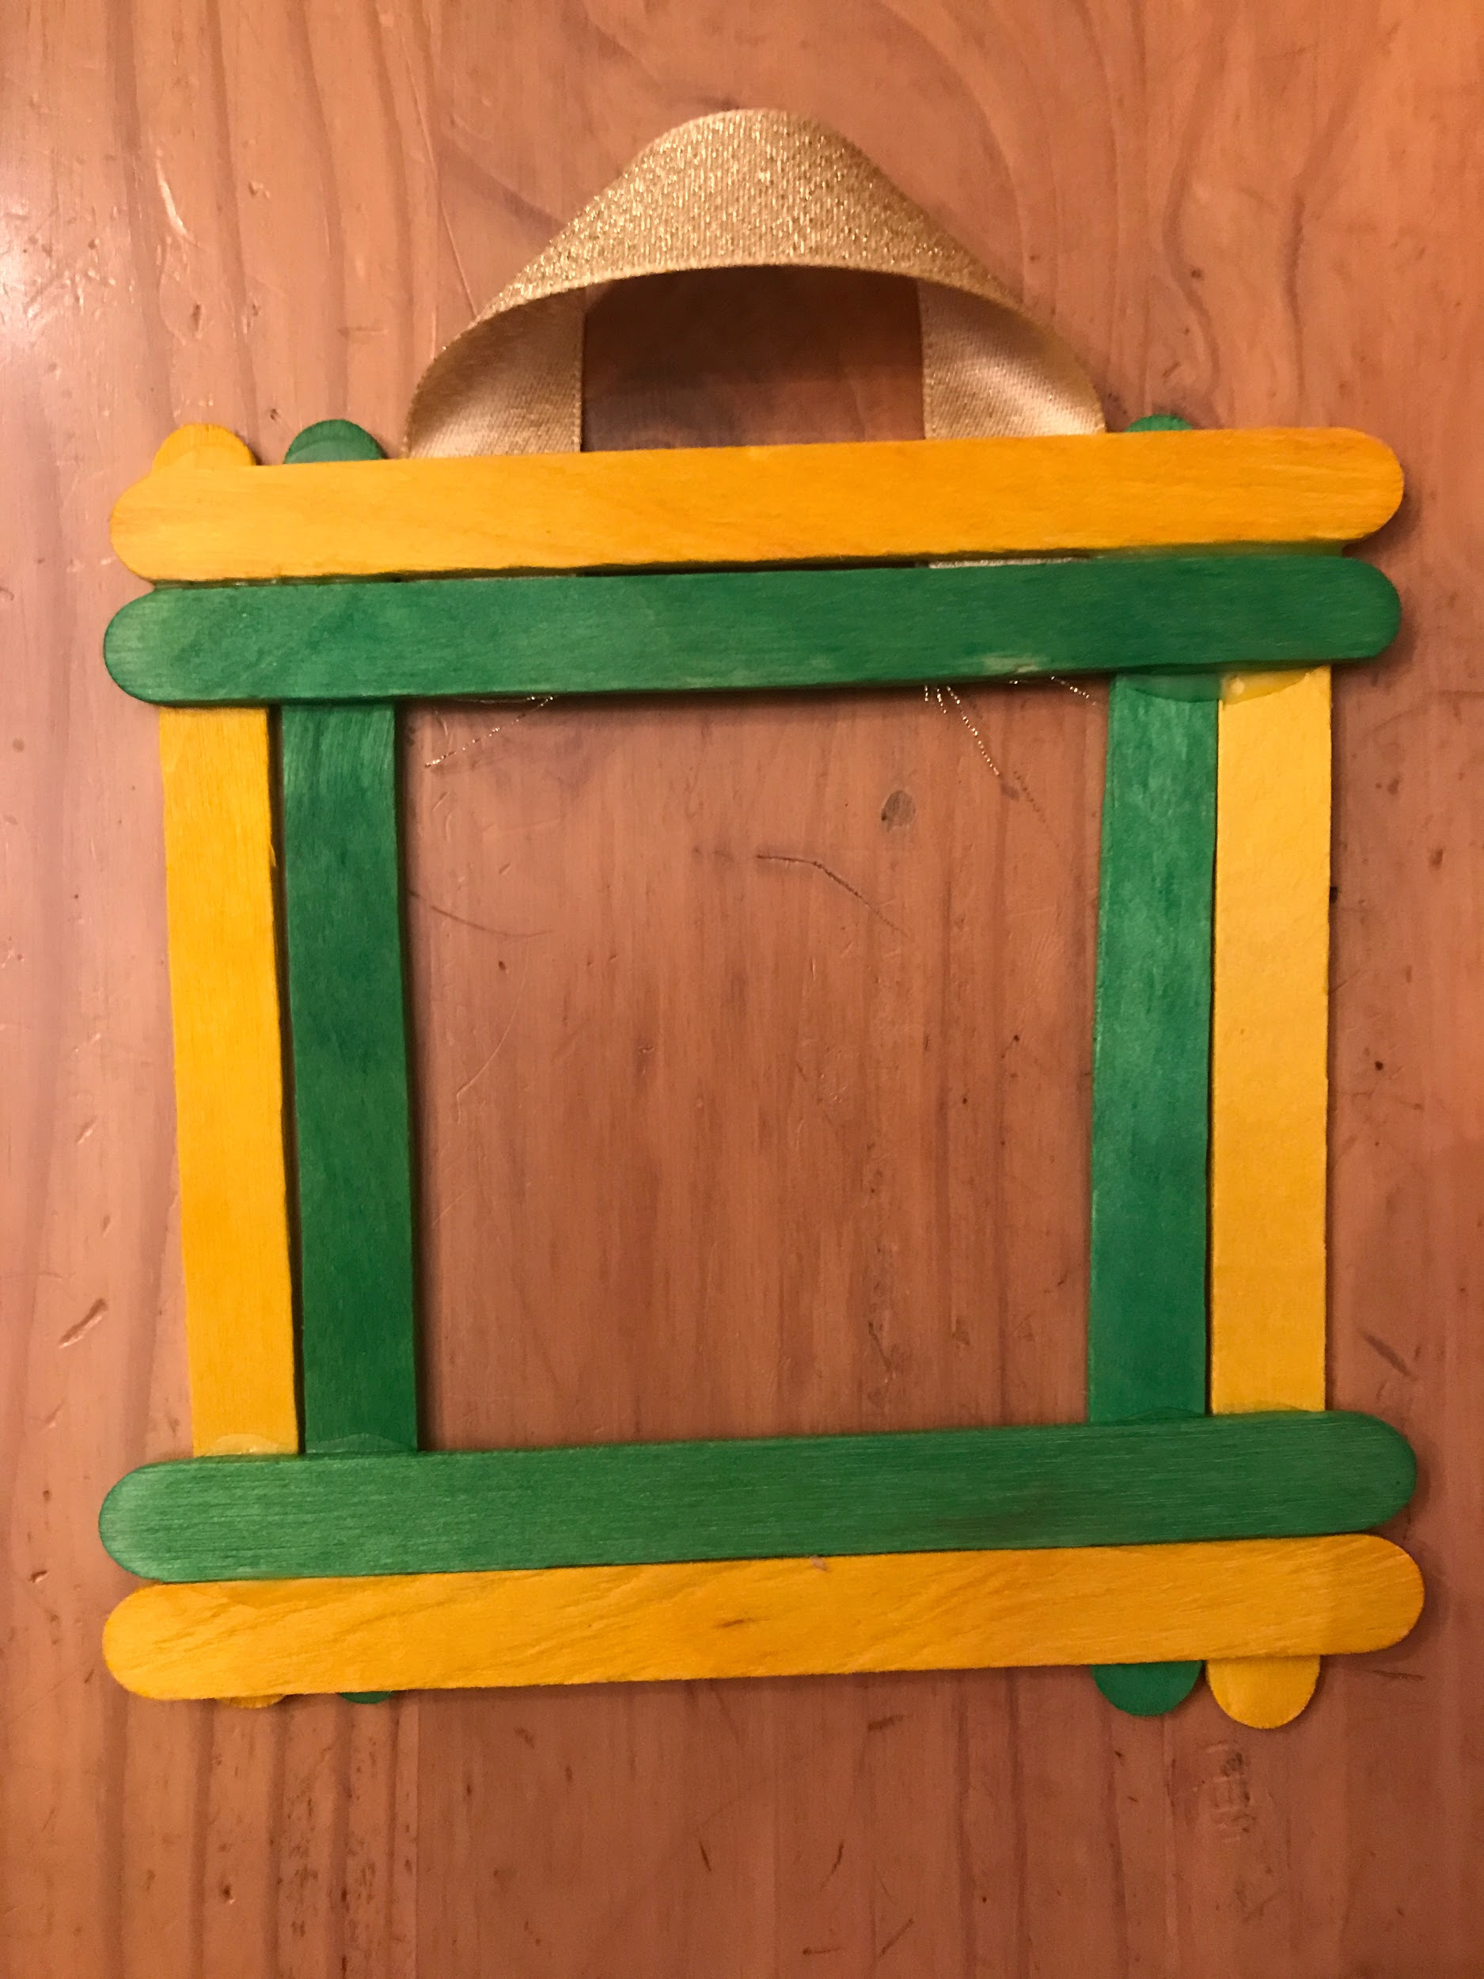
Frames with Magnets Frames with Ribbon

Slide 12
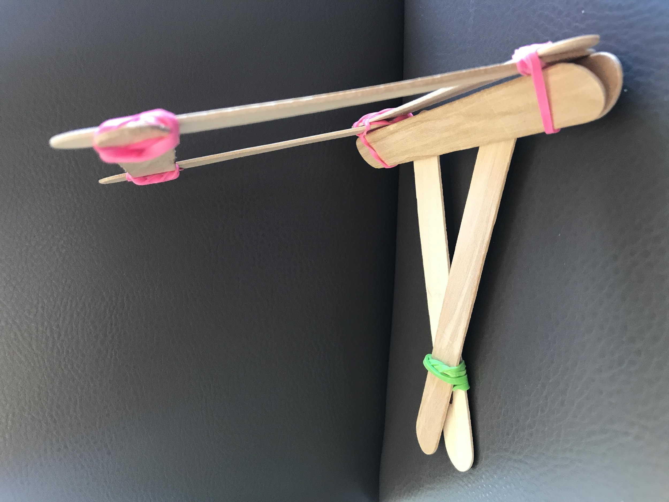
Frames with Rubberbands
Front (4 sticks for front) Side (4 sticks for the stand)

Slide 13
TASK: Our class is going to make picture frames for a class display to honor our loved ones.
1) Decide what kind of frame or frames we should make. 2) Make a plan that shows how many packages of popsicle sticks you will need to so that everyone in our class can make at least one picture frame for our class display. We want to have enough popsicle sticks, but not many leftovers. 3) Extension: Shows what materials we need to hang or stand the frames (rubber bands, ribbon, magnets)

Slide 14
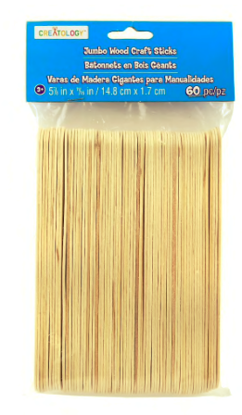
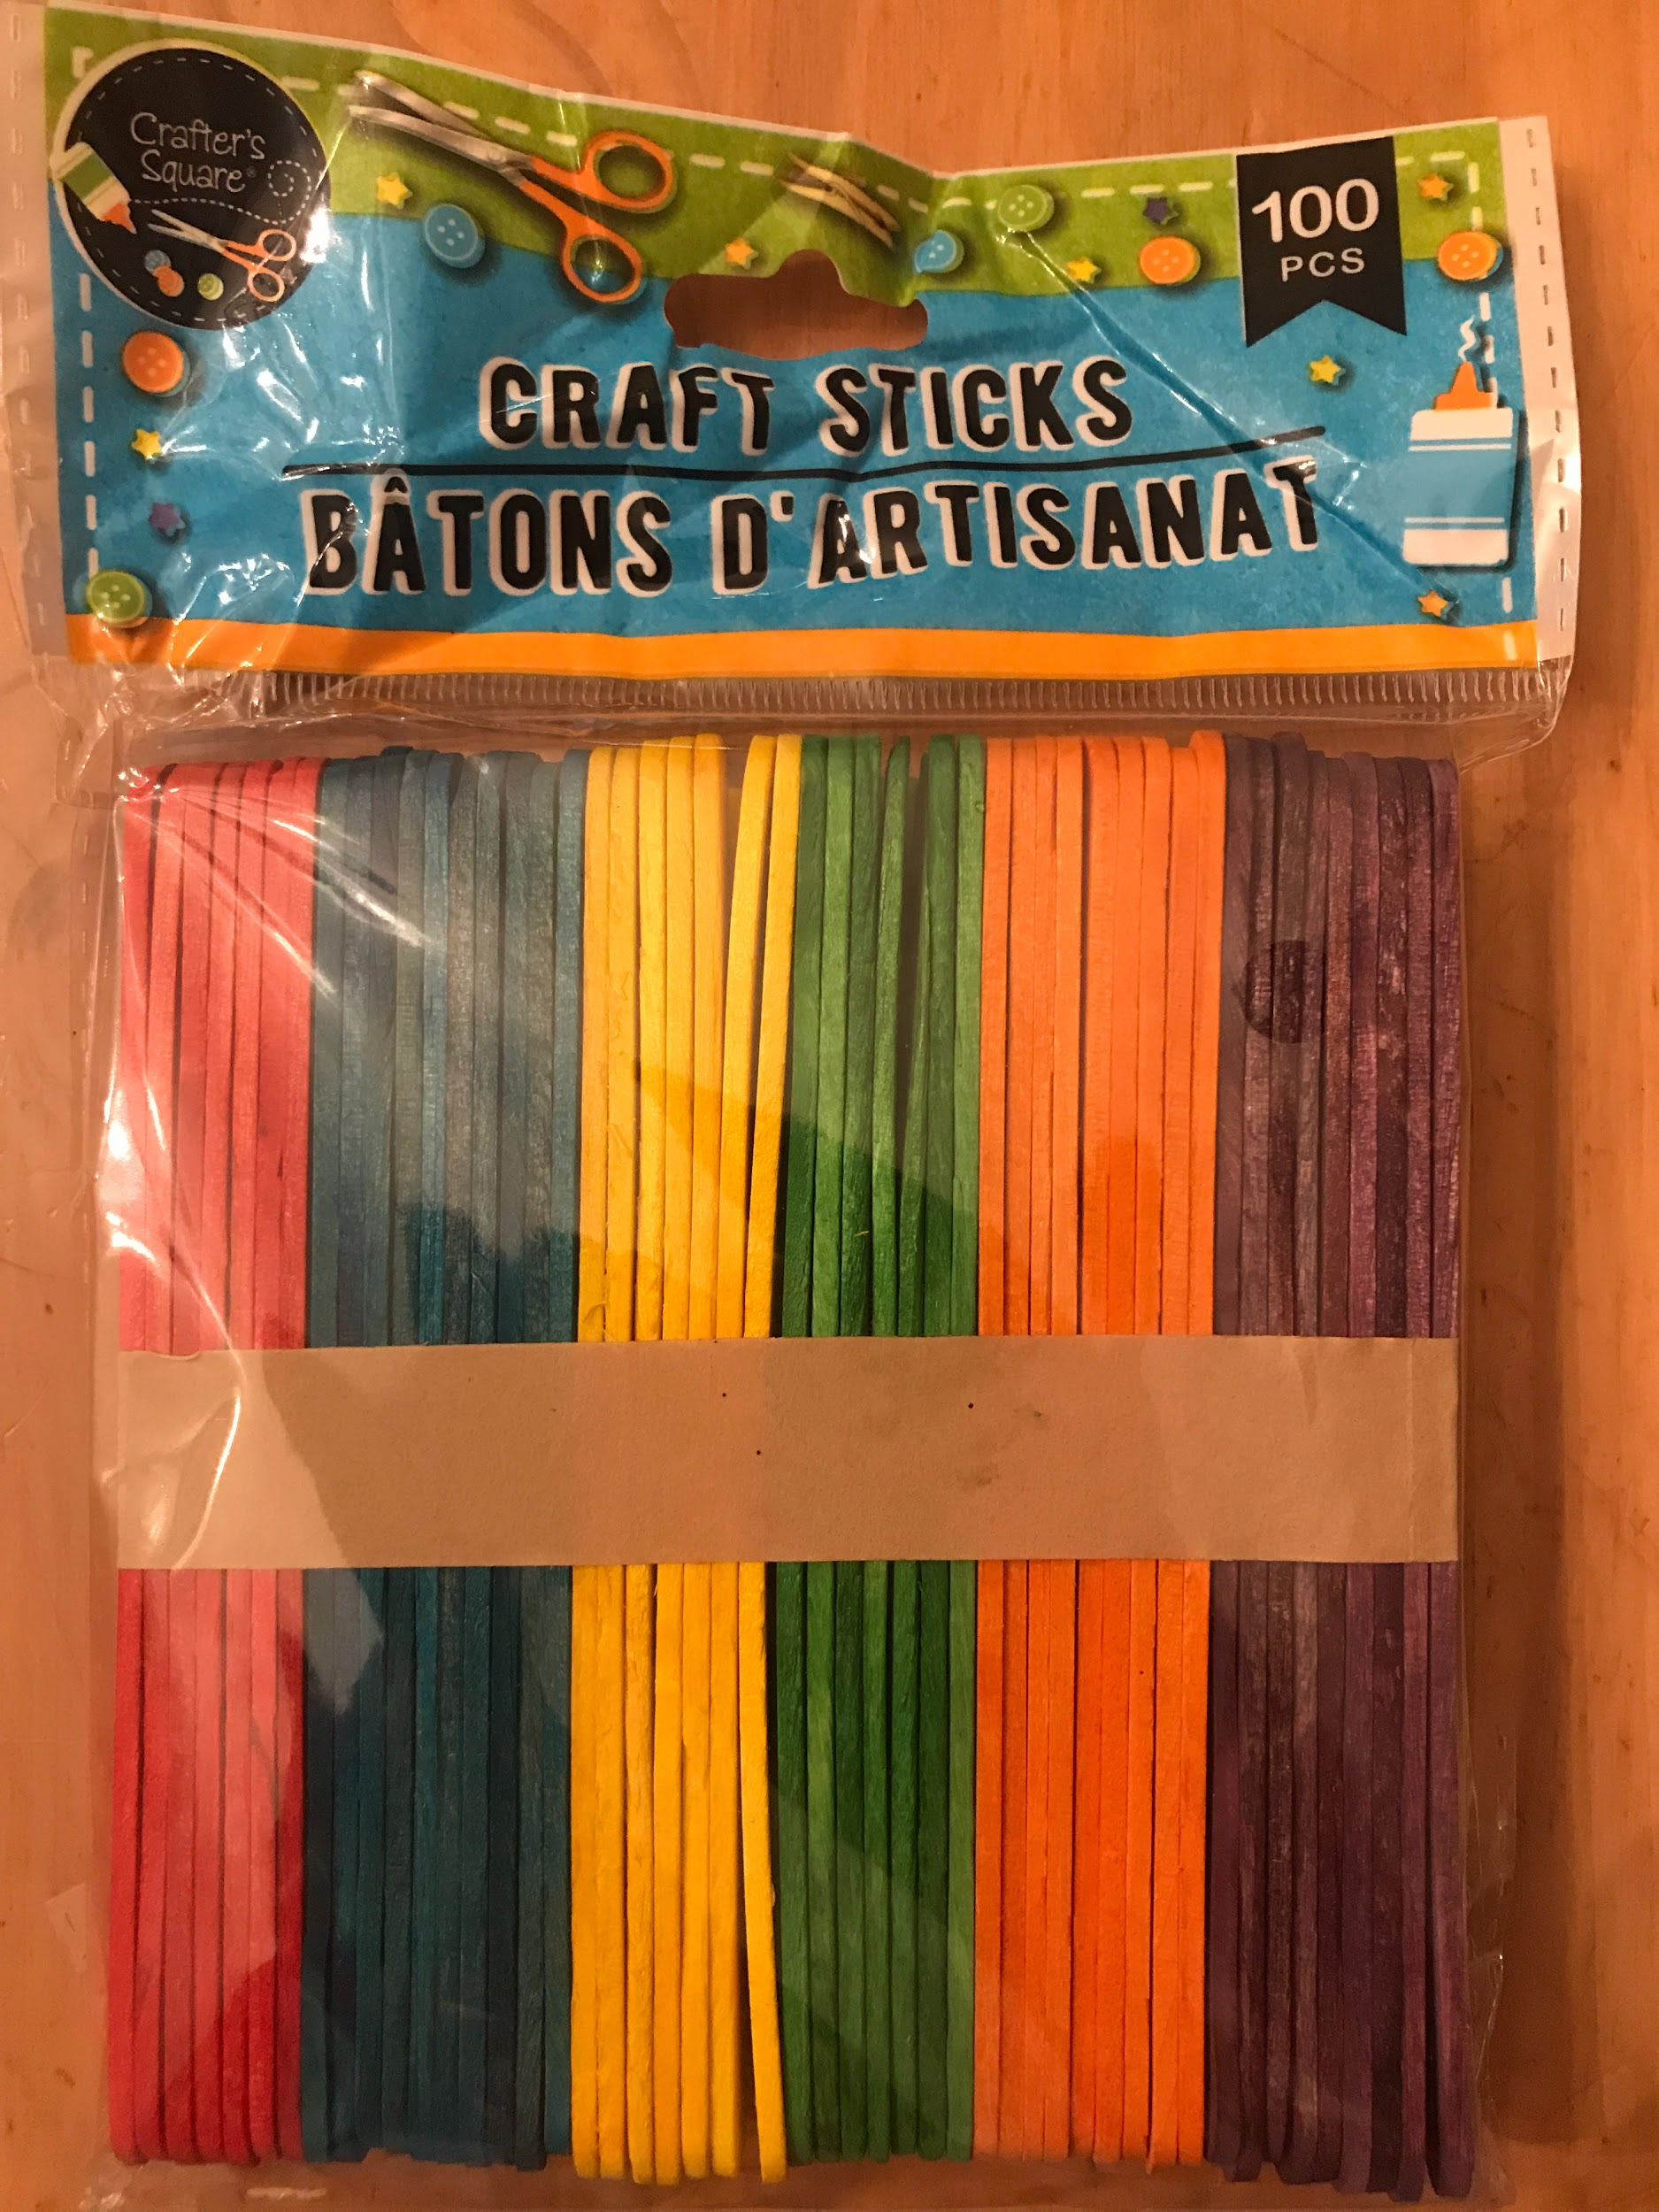
Packages of Popsicle Sticks
60 plain jumbo sticks 100 multi-colored sticks

Slide 15
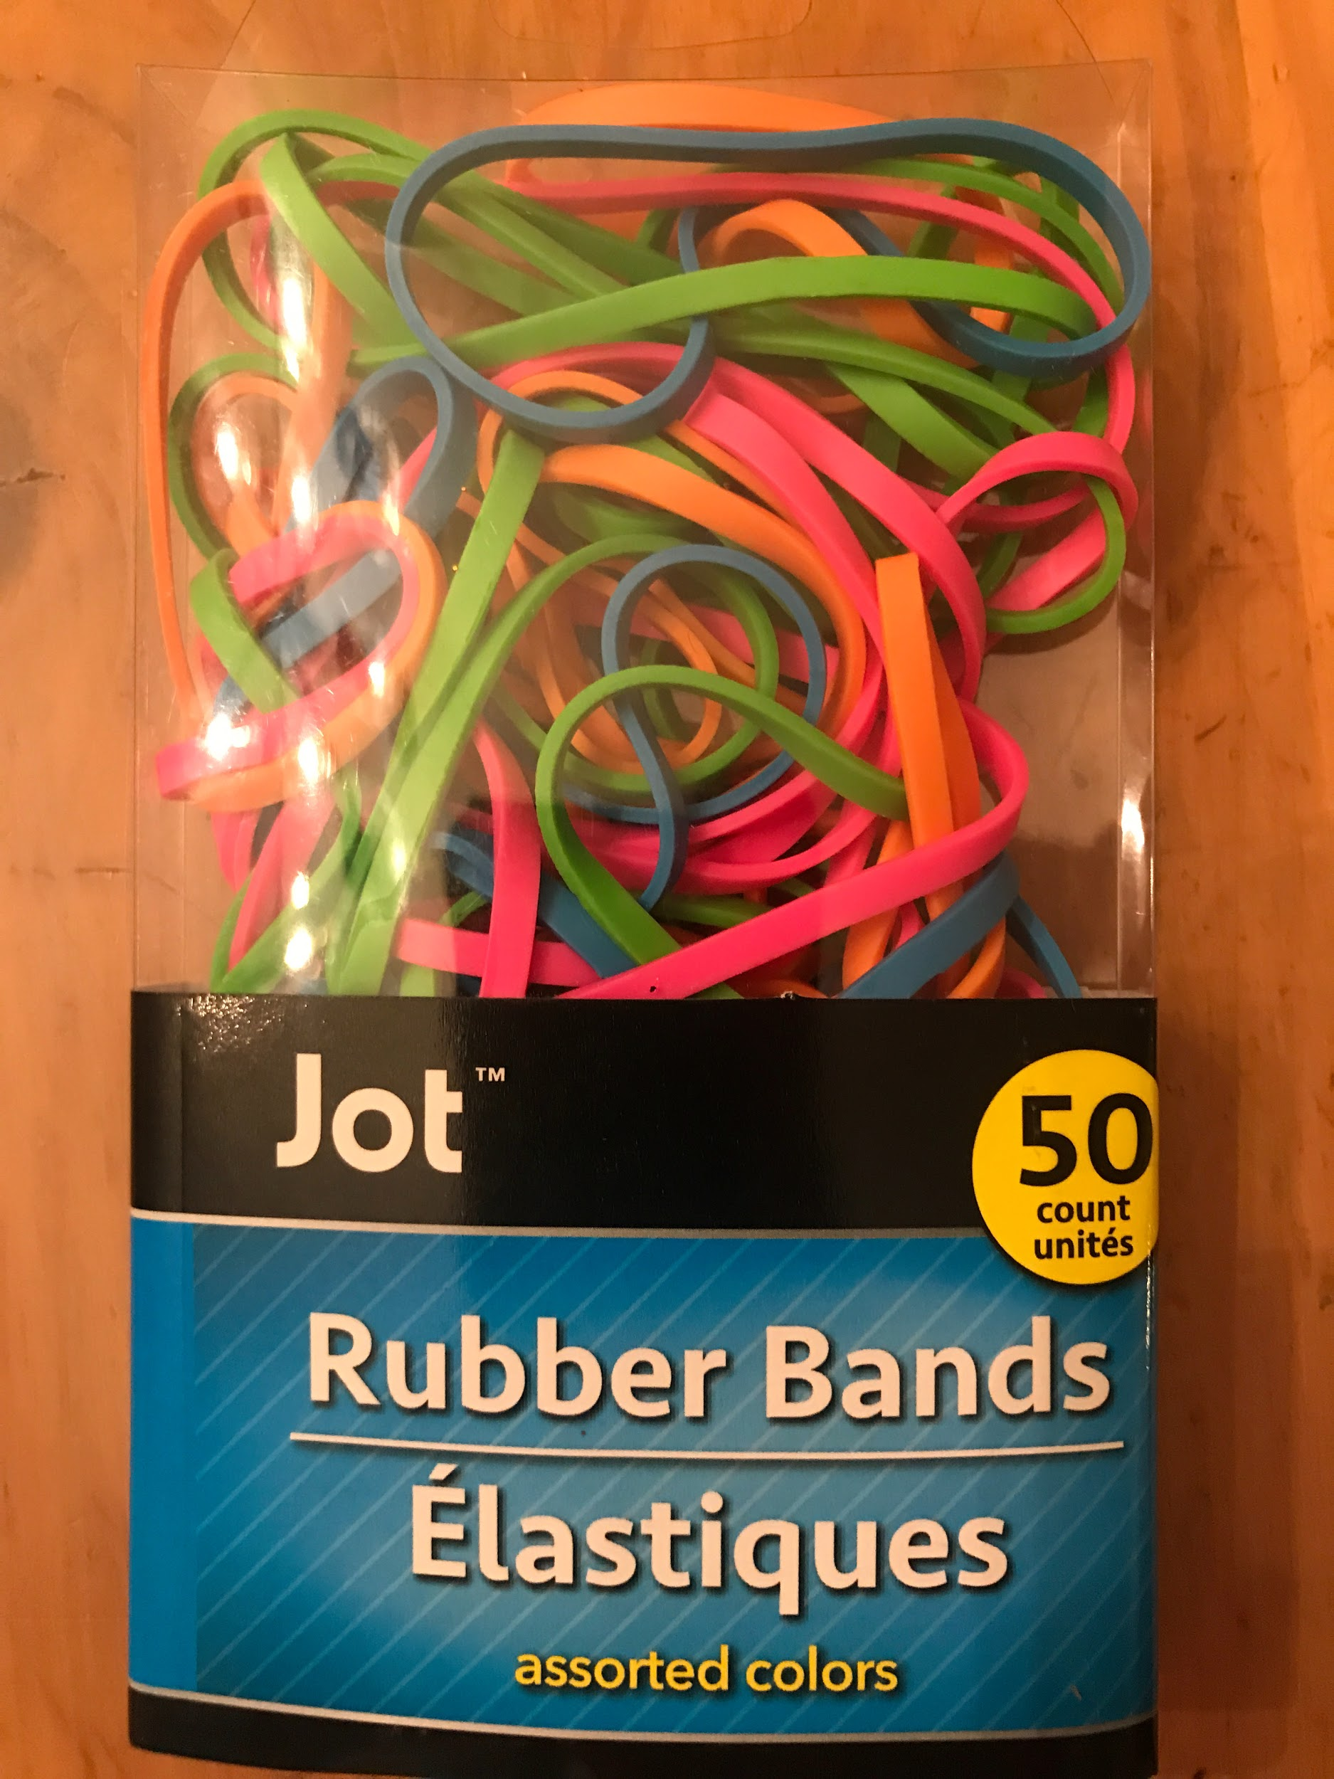
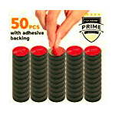
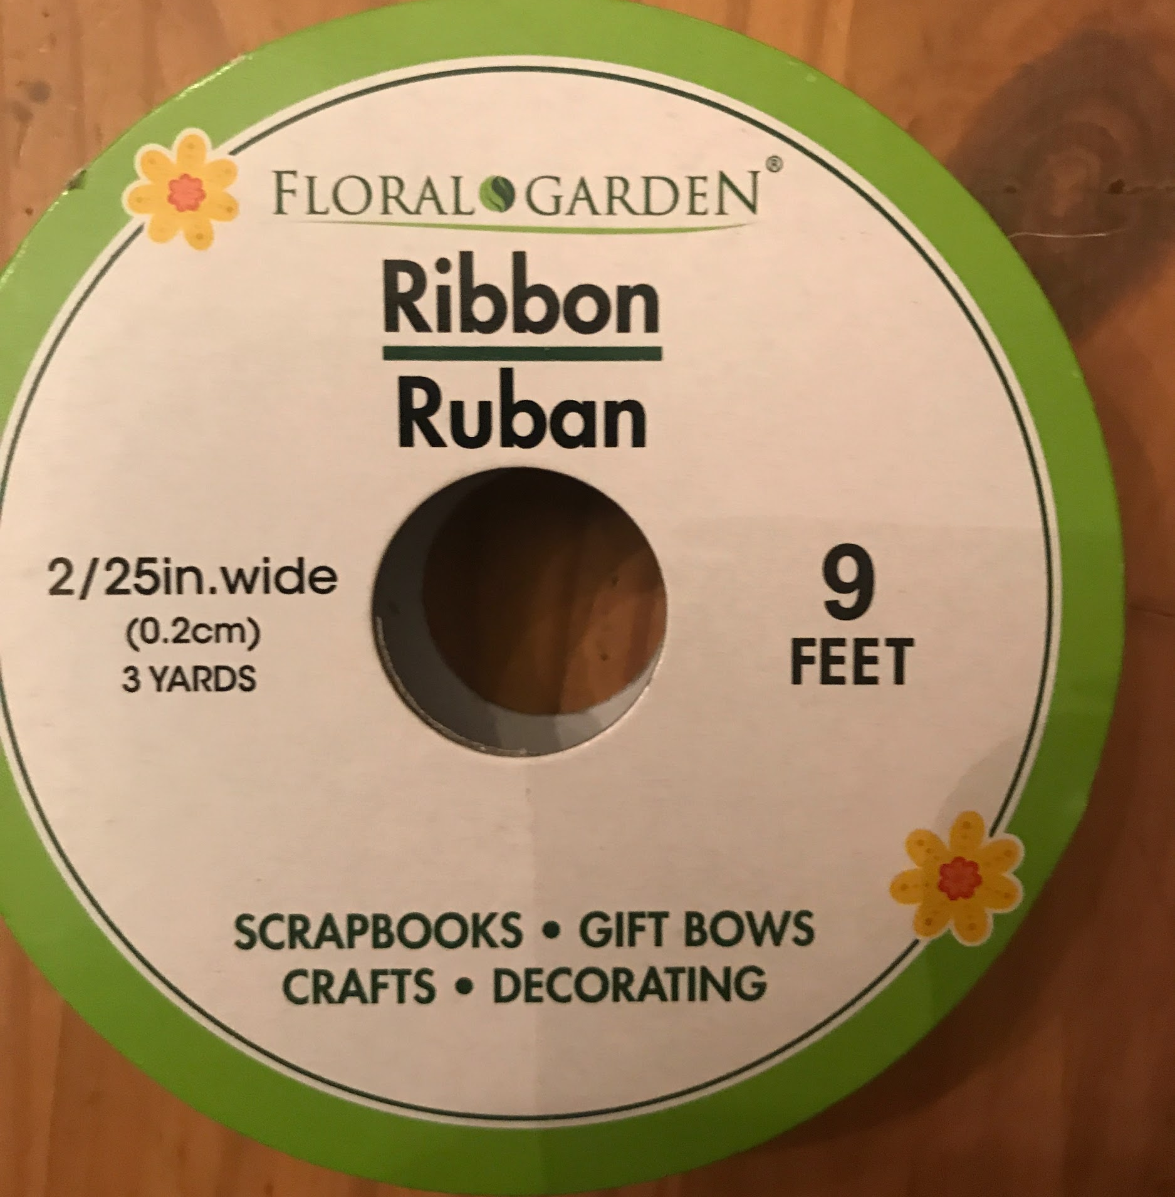
Other Materials
Rubber bands (50 per package)
Magnets (50 per package)
Ribbon for hanging (9 feet per spool)

Slide 16
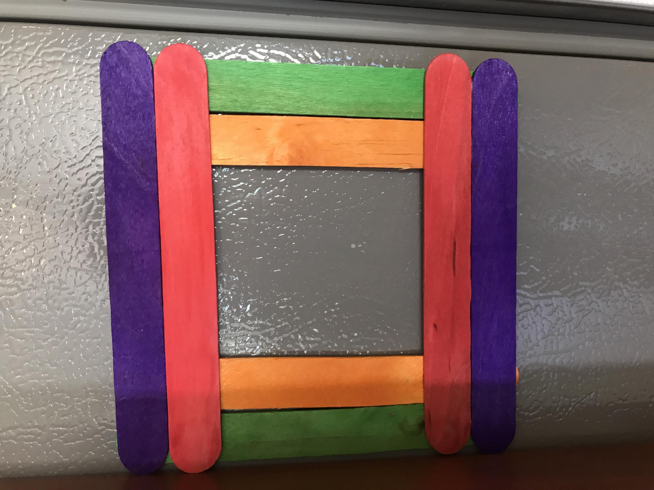
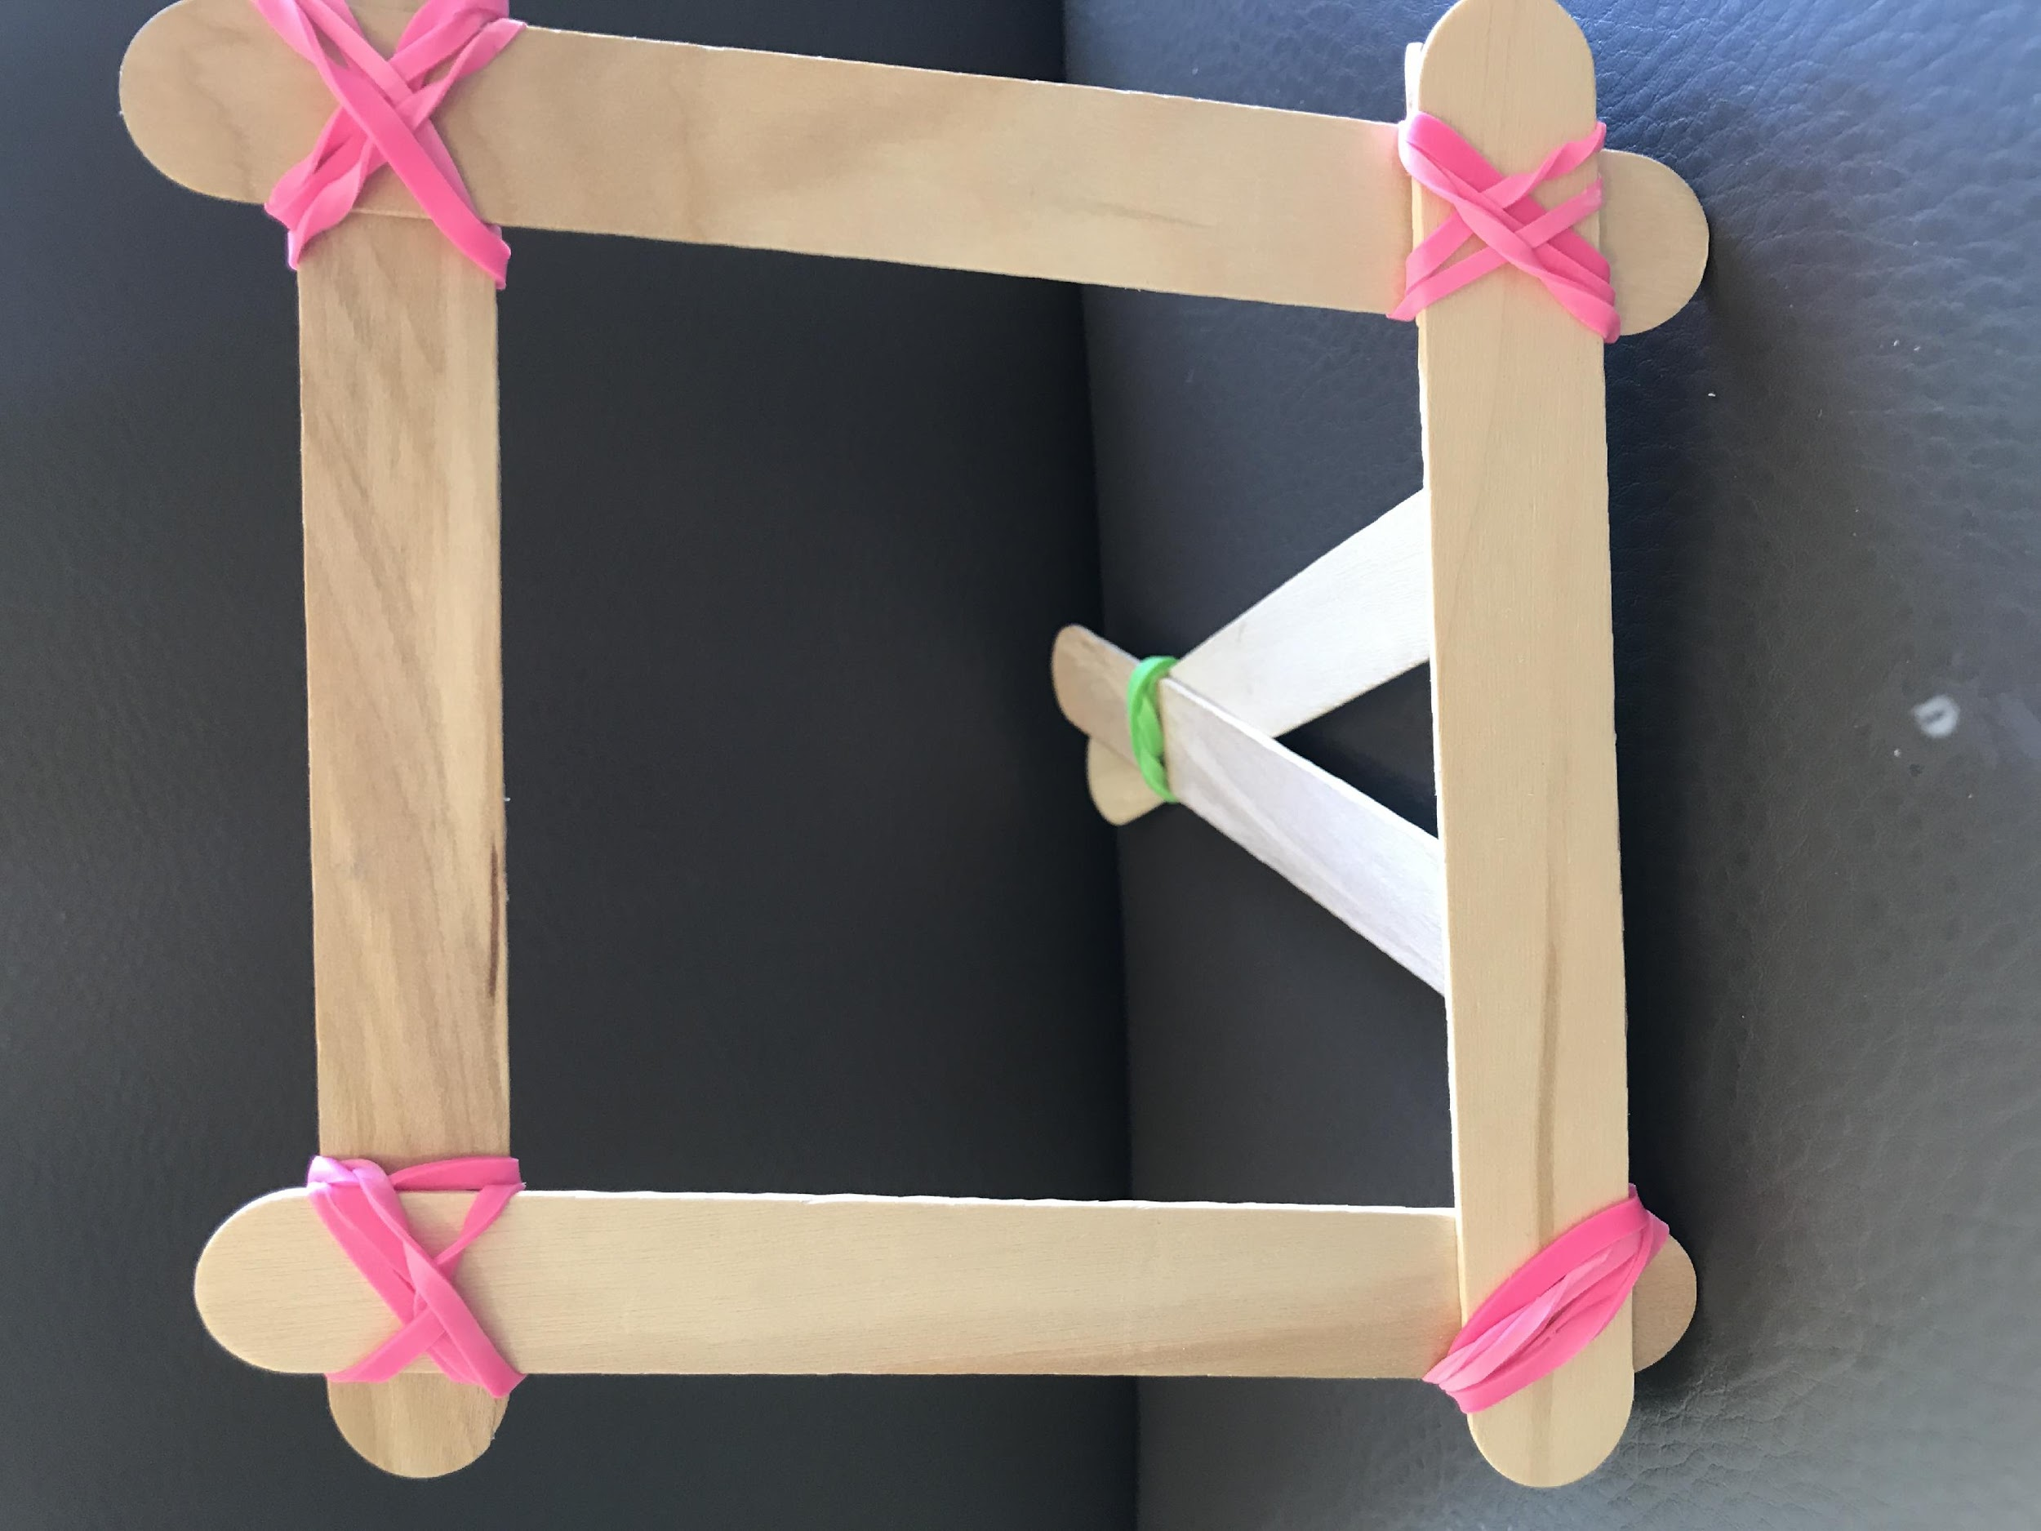
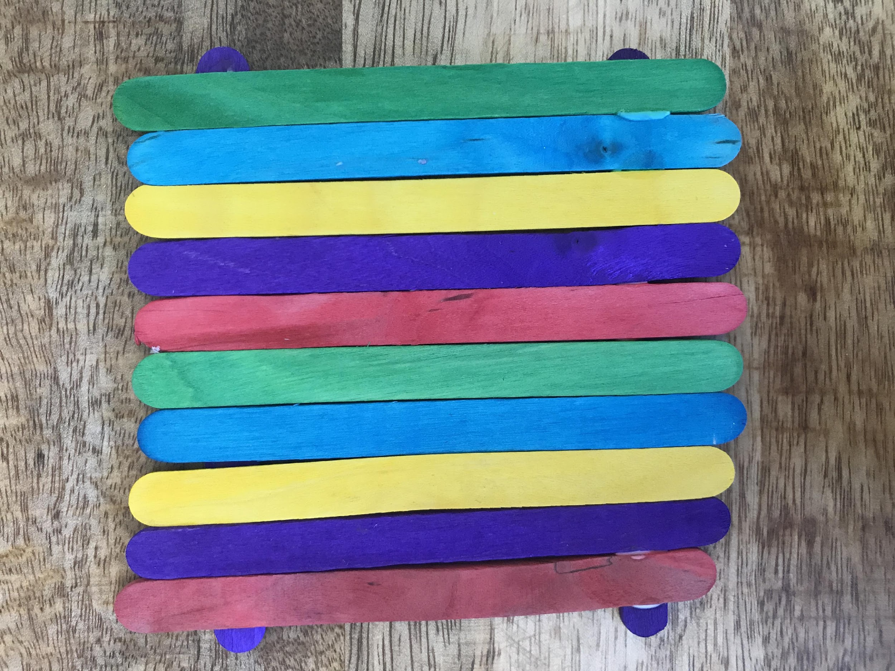
Making Picture Frames: One Frame
Decide what kind of frame we should make for our class display.
Use the popsicle sticks to plan your frame. Make a quick sketch.
Figure out how many popsicle sticks you need to make 1 frame.
Number of Plain Jumbo Sticks
Number of Multi-color Sticks
Figure out what other materials you need for 1 frame.

Slide 17
Making Picture Frames: 2 Different Frames
Decide what kind of frames we should make for our class display.
Use the popsicle sticks to plan each frame. Sketch your picture frame designs.
Figure out how many popsicle sticks you need to make 1 of each frame.
Number of Plain Jumbo Sticks
Number of Multi-color Sticks
Figure out what other materials you need to make 1 of each frame.

Slide 18
Making Picture Frames: CLASS DISPLAY
How many packages of popsicle sticks do you need so that every student in your class can make at least one picture frame (using your design) for the class display?
What do we know that could help us? | What do we need to know? | What do we need to decide? What assumptions do we need to make?

Slide 19
Making Picture Frames for Class Display:
One Frame
CLASS DISPLAY
Your plan should explain:
your assumptions and decisions
which frame the class should make
how many frames the class should make
the number of packages of each type of popsicle stick needed for all the frames
how many popsicle sticks you will have leftover
how much of other materials needed to make all the frames
Use pictures, numbers, equations and words to show that your plan will work.
Explain how another group could use your plan to make picture frames for their Honor display.

Slide 20
Making Picture Frames for Class Display:
2 Different Frames
Your plan should show:
your assumptions and decisions
which frames the class should make
how many of each frame the class should make
the number of packages of each type of popsicle stick needed for all the frames
how many popsicle sticks you will have leftover
how much of other materials needed to make all the frames
Use pictures, numbers, equations and words to show that your plan will work.
Explain how another group could use your plan to make picture frames for their Honor display.

Slide 21
Assumptions and Decisions | Sketch each frame in your plan. How many popsicle sticks are needed for 1 frame? What other materials are needed?
Show how many packages of popsicle sticks are needed to make all the picture frames in your plan. | Show what other materials are needed to make all the picture frames in your plan.

Slide 22
Comparing Plans
Team |  | Number of Sticks for 1 frame (sketch the frame) | Number of Frames | Number of Sticks in all | Number of Packages | Number of sticks leftover
 | Plain Jumbo Sticks
 | Multicolor Sticks

Slide 23
Writing Letters
Write a letter that describes the materials needed for making the picture frames for the class display.
Be clear so that the person knows how much material to order.

Slide 24
EXTRA SLIDES

Slide 25
http://coasthwytraders.com/tag/dia-de-los-muertos/

Slide 26
OPTIONAL Video
How to make a frame with rubberbands that stands up
https://www.youtube.com/watch?v=gXNacbh9zvs

